Slide 1
Tokens,Variables & Datatypes

Slide 2
TOPICS
CHARACTER SET
CONSTANTS
VARIABLES
DATATYPES(PRIMITIVE)
SAMPLE PROGRAMS & MCQ

Slide 3
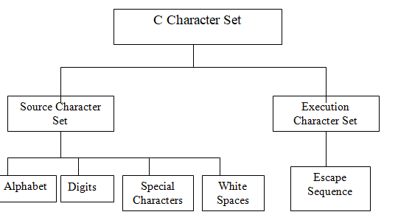
CHARACTER SET

Slide 4
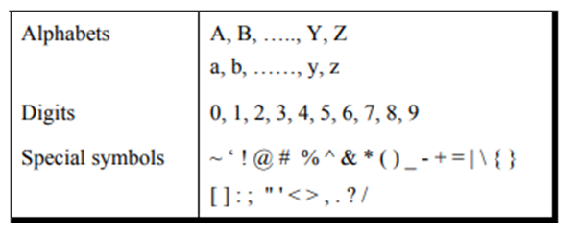
SOURCE CHARACTER SET
Used to construct the statements in the source program.
A character denotes any alphabet, digit or special symbol used to represent information. The following Figure shows the valid alphabets, numbers and special symbols allowed in C.
The alphabets, numbers and special symbols when properly combined form tokens.

Slide 5
EXECUTION CHARACTER SET
It is also called as “Escape sequences”.
This set of characters are also called as non graphic characters because, these characters are invisible and cannot be printed directly.
These characters will have effect only when the program is executed.
CODE | MEANING
\b | Backspace
\f | Form feed
\n | New line
\r | Carriage return
\t | Horizontal tab
\" | Double quote
\̍ | Single quote
\0 | Null
\\ | Backslash
\v | Vertical Tab
\a | Alert

Slide 6
EXECUTION CHARACTER SET-Example Program
#include <stdio.h>
int main()
{
printf("\"Hello World");
return 0;
}
OUTPUT:
"Hello World
#include <stdio.h>
int main()
{
printf("\'Wel\tcome to \nREC\'"); return 0;
}
OUTPUT:
'Wel come to
REC'

Slide 7
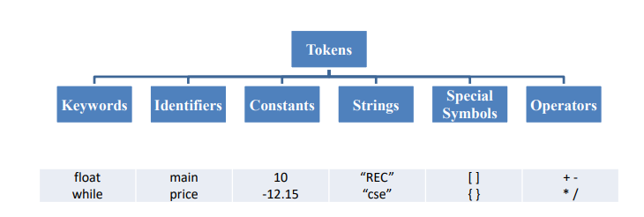
C TOKENS
In C program, the smallest individual units are known as C tokens.
Types of Tokens:

Slide 8
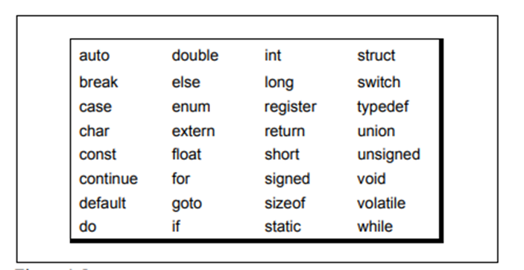
C KEYWORDS
Keywords are the words whose meaning has already been explained to the C compiler.
The keywords cannot be used as variable names The keywords are also called ‘Reserved words’.
There are only 32 keywords available in C. The following Figure gives a list of these keywords for your ready reference.

Slide 9
Identifiers in C
Used for naming variables, functions, arrays, structures, etc.
Identifiers in C are the user-defined words.
Rules for constructing identifiers in C
The first character of an identifier should be either an alphabet or an underscore, and then it can be followed by any of the character, digit, or underscore.
It should not begin with any numerical digit.
In identifiers, both uppercase and lowercase letters are distinct. Therefore, we can say that identifiers are case sensitive.
Commas or blank spaces cannot be specified within an identifier.
Keywords cannot be represented as an identifier.
The length of the identifiers should not be more than 31 characters.

Slide 10
Strings in C
Sequence of character.
Strings in C are enclosed within double quotes, while
characters are enclosed within single characters.
Example:
“Hello”
‘A’

Slide 11
Operators in C
Symbol used to perform the operation
Example:
+,-,/,*,%,++,--,<<,>>,&&,||,!

Slide 12
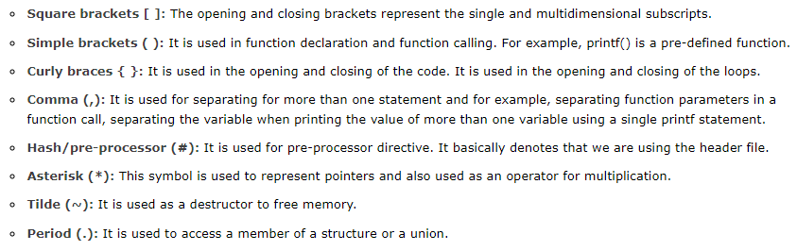
Special Symbols

Slide 13
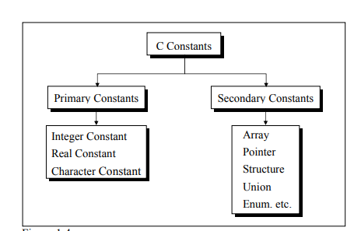
CONSTANTS
A constant is an entity that doesn’t change its value.
C constants can be divided into two major categories:
Primary Constants
Secondary Constants

Slide 14
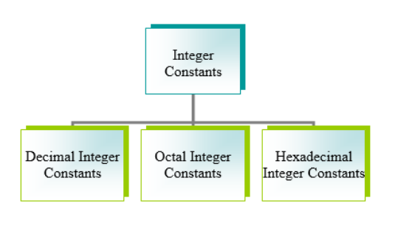
INTEGER CONSTANTS

Slide 15
INTEGER CONSTANTS
C accepts integer constants in three numbering systems - decimal, octal and hexadecimal.
Decimal Integer Constant-Decimal integer constants can consist any combinations of digits from 0 to 9, preceded by an optional + or – sign.(Eg: 98, +47, -87)
Octal Integer Constant-Octal integer constants can consist of any combinations of digits from 0 to 7. C specifies that the octal integer must be preceded by a 0.(Eg:010, 07,0240)
Hexadecimal Integer Constant-Hexadecimal integer constants can consist of any combination of digits from 0 to 9 and letters from A to F (either uppercase or lowercase represents 10 to15)
A hexadecimal integer constant must begin with either 0x or 0X( Eg:0x2,0X2A,0Xab)

Slide 16
INTEGER CONSTANTS
Rules for Constructing Integer Constants
An integer constant must have at least one digit.
It must not have a decimal point.
It can be either positive or negative.
If no sign precedes an integer constant it is assumed to be positive.
No commas or blanks are allowed within an integer constant.
The allowable range for integer constants depends upon the compiler
Ex.: 426
+782
-8000
-7605

Slide 17
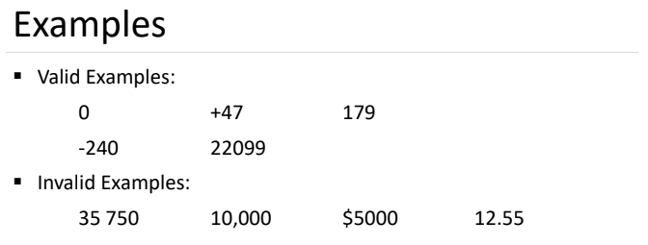

Slide 18
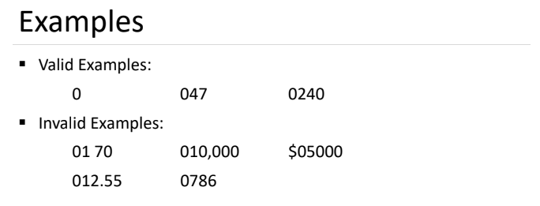

Slide 19
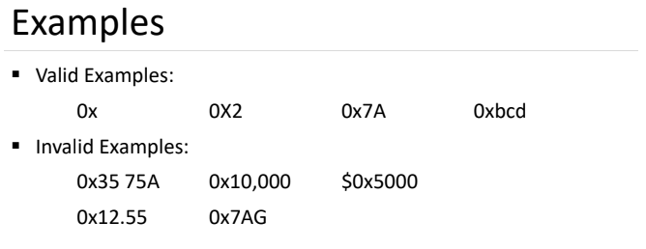

Slide 20
INTEGER CONSTANTS-Example
Example: 1
printf (“%d %d %d %d”, 45, 045, 0x45, 0X45);
What it will print?
The decimal equivalent of all the constants will be printed.
45 33 65 65
Example: 2
printf (“ %o %x”, 45, 45);
What it will print?
The octal and hexadecimal equivalent of 45 will be printed.
55 2D

Slide 21
INTEGER CONSTANTS-MCQ
An integer constant in C must have:
(1) At least one digit
(2) At-least one decimal point
(3) A comma along with digits
(4) Digits separated by commas
ANSWER:1

Slide 22
REAL CONSTANTS (FLOATINT POINT CONSTANTS)
Real constants are often called Floating Point constants. The real constants could be written in two forms—Fractional form and Exponential form.
Real constants expressed in fractional form
A real constant must have at least one digit.
It must have a decimal point.
It could be either positive or negative.
Default sign is positive.
No commas or blanks are allowed within a real constant.
Ex.: +325.34
426.0
-32.76
-48.5792

Slide 23
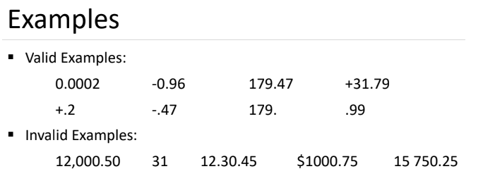

Slide 24
REAL CONSTANTS (FLOATINT POINT CONSTANTS)
Example: 1
printf("%f %f",+456.67,-67.89);
What it will print?
456.670000 -67.890000

Slide 25
REAL CONSTANTS (FLOATINT POINT CONSTANTS)
Real constants expressed in exponential form
The mantissa part and the exponential part should be separated by a letter e.
The mantissa part may have a positive or negative sign.
Default sign of mantissa part is positive.
The exponent must have at least one digit, which must be a positive or negative integer. Default sign is positive.
Range of real constants expressed in exponential form is -3.4e38 to 3.4e38.
Ex.: +3.2e-5
4.1e8
-0.2e+3
-3.2e-5

Slide 26
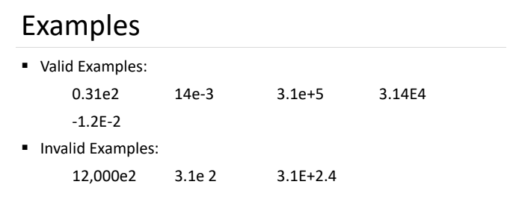

Slide 27
REAL CONSTANTS (FLOATINT POINT CONSTANTS)
Example: 1
printf ("%f %f",4.1e8,-3.2e-5);
What it will print?
410000000.000000 -.000032

Slide 28
CHARACTER CONSTANTS
Rules for Constructing Character Constants
A character constant is a single alphabet, a single digit or a single special symbol enclosed within single inverted commas.
The maximum length of a character constant can be 1 character.
Ex.: 'A'
'I'
'5'
'='

Slide 29
CHARACTER CONSTANTS-Example
Example: 1
printf ("%c %c",'a','5');
printf ("%d %d",'a','5');
What it will print?
a 5 (%c will print the actual character as such)
97 53 (%d will print the ASCII value of the character)

Slide 30
CHARACTER CONSTANTS-MCQ
Example 2:
Which of the following is NOT a character constant
(1) ‘Thank You’
(2) ‘Enter values of P, N, R’
(3) ‘23.56E-03’
(4) All the above
ANSWER: 4

Slide 31
VARIABLES
Variable is a name used for storing a data value.
Its value may be changed during the program execution.
Variable names are names given to locations in memory.
These locations can contain integer, real or character constants.
Rules for defining variables is same as Identifier.

Slide 32
VARIABLES
DECLARING A VARIABLE:
The declaration of variables must be done before they are used in the program.
It tells the compiler what the variable name is and it specifies what type of data the variable will hold.
A variable declaration consists of a data type name followed by a list of one or more variables of that type separated by commas.
Syntax:
datatype var1, var2, . . . varN;// here var1,var2..varN are names of the variable
Eg: int sum;
The variables will contain some garbage value when they are declared.

Slide 33
VARIABLES
ASSIGNING VALUES TO VARIABLE:
Values can be assigned to variables using the assignment operator =.
Syntax:
variablename = value;
int x;
x=100;

Slide 34
VARIABLES
INITIALIZING VALUE TO VARIABLE:
The process of giving an initial value to variables is called initialization.
C permits the initialization of more than one variable in one statement using multiple assignment operators.
Example:
int a = 0;
int x,y,z;
x = y = z = 1;

Slide 35
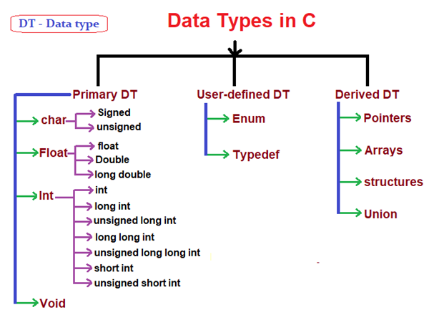
DATA TYPES IN C
A data type specifies the type of data that a variable can store such as integer, floating, character, etc.. ANSI C provides three types of data types:

Slide 36
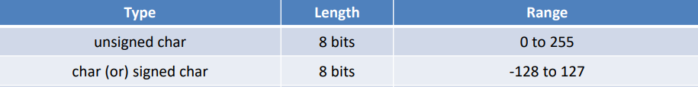
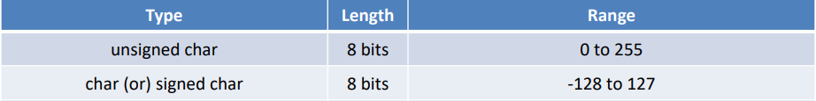
PRIMARY (BUILT-IN) DATA TYPES:
char:
The most basic data type in C. It stores a single character and requires a single byte of memory in almost all compilers.
TURBO C COMPILER
GCC COMPILER

Slide 37
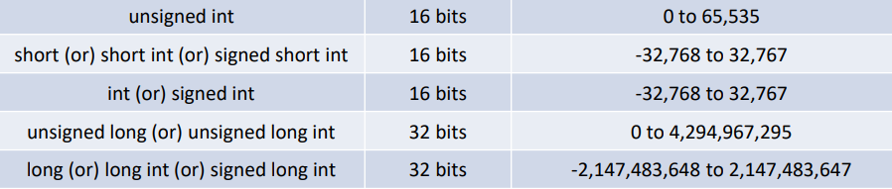
PRIMARY (BUILT-IN) DATA TYPES:
int:
int datatype is used to store whole numbers.
TURBO C COMPILER

Slide 38
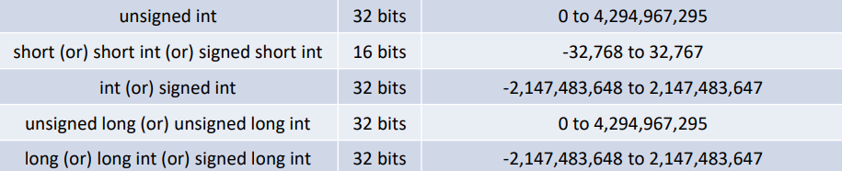
PRIMARY (BUILT-IN) DATA TYPES:
int:
int datatype is used to store whole numbers.
GCC COMPILER

Slide 39
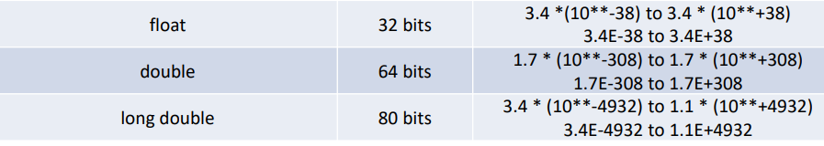
PRIMARY (BUILT-IN) DATA TYPES:
float and double:
Floating types are used to store real numbers.
float: A single-precision floating point value.
Double: A double-precision floating point value.
TURBO C COMPILER

Slide 40
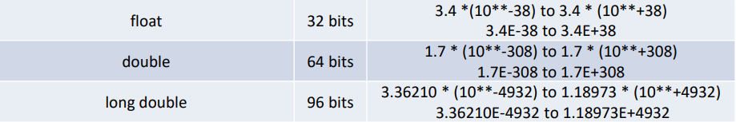
PRIMARY (BUILT-IN) DATA TYPES:
float and double:
Floating types are used to store real numbers.
float: A single-precision floating point value.
Double: A double-precision floating point value.
GCC COMPILER

Slide 41
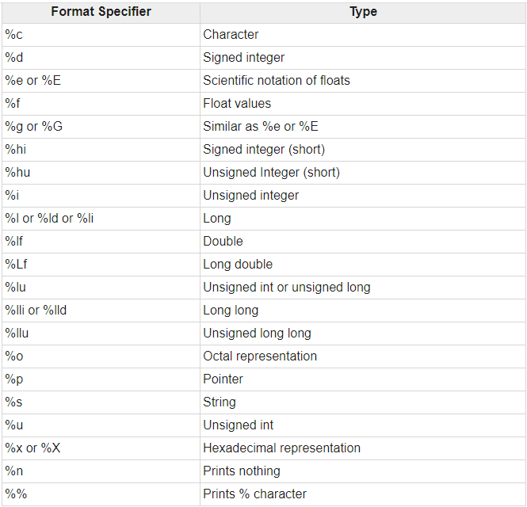

Slide 42
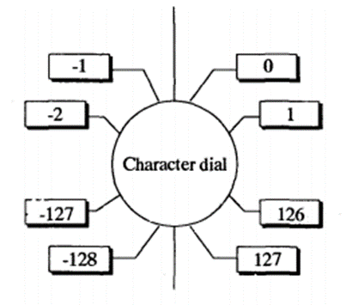
CHARACTER DIAL
The range of the signed char datatype is -128 to 127.The range values is logically viewed in the form of a dial.
#include <stdio.h>
int main()
{
char a = 128;
printf("%d",a );
return 0;
}
OUTPUT:-128

Slide 43
POINT OUT THE ERRORS, IF ANY, IN THE FOLLOWING C STATEMENTS:
1. int = 314.562 * 150 ;
Error: variable name is missing/identifier is expected
2. name = ‘Ajay’ ;
Error: datatype is missing/ name variable is undeclared
3. varchar = ‘3’;
Error: datatype is missing/ name variable is undeclared

Slide 44
POINT OUT THE ERRORS, IF ANY, IN THE FOLLOWING C STATEMENTS:
1. int = 314.562 * 150 ;
Error: variable name is missing/identifier is expected
2. name = ‘Ajay’ ;
Error: datatype is missing/ name variable is undeclared
3. varchar = ‘3’;
Error: datatype is missing/ name variable is undeclared

Slide 45
MULTIPLE CHOICE QUESTIONS
What is the output of this C code?
#include <stdio.h>
int main()
{
printf("Hello World! %d \n", x);
return 0;
}
A. Hello World! x;
B. Hello World! followed by a junk value
C. Compile time error
D. Hello World!
ANSWER:C

Slide 46
MULTIPLE CHOICE QUESTIONS
#include <stdio.h>
int main()
{
int main = 10;
printf("%d", main);
return 0;
}
A. It will cause a compilation error
B. It will cause a run-time error
C. It will run without any error and prints 10
D. It will experience infinite looping
ANSWER: C (It will run without any error and prints 10 as ‘main’ is not a keyword and can be used as a variable)

Slide 47
MULTIPLE CHOICE QUESTIONS
What will be the output of the following C code? [Assume it’s a 32-bit system]
#include <stdio.h>
int main()
{
int x = 70;
printf("%c", x);
return 0
}
A. 70
B. F
C. 70.0
D. Compilation error
ANSWER:B

Slide 48
MULTIPLE CHOICE QUESTIONS
The statement char ch = ‘Z’ would store what in ch
i. The character Z
ii. ASCII value of Z
iii. Z along with the single inverted commas
iv. Both (1) and (2)
ANSWER: B

Slide 49
MULTIPLE CHOICE QUESTIONS
A C variable cannot start with
A. An alphabet
B. A number
C. A special symbol other than underscore
D. Both (2) & (3) above
ANSWER:D

Slide 50
WHAT WILL BE THE OUTPUT?
#include <stdio.h>
int main()
{
char a;
float b;
int c;
printf("%d %d %d\n", sizeof(char), sizeof(int), sizeof(float));
printf("%d %d %d\n", sizeof(a), sizeof(b), sizeof(c));
printf("%d %d %d ", sizeof('7'), sizeof(7), sizeof(7.0));
return 0;
}
OUTPUT:
1 4 4
1 4 4
4 4 8

Slide 51
WHAT WILL BE THE OUTPUT?
#include <stdio.h>
int main()
{
char ch = 291;
printf("%d %d %c", 2147483648, ch, ch);
return 0;
}
OUTPUT:
-2147483648 35 #

Slide 52
WHAT WILL BE THE OUTPUT?
#include <stdio.h>
int main()
{
unsigned char c = 257;
char a='1270';
char b='123a';
printf("%c %d\n",a,a);
printf("%c %d\n",b,b);
printf("%d %d\n", c, c);
return 0;
}
OUTPUT
0 48
a 97
1 1

Slide 54
PROBLEM 1:
If the mark obtained by a student is given for 3 subjects find out the aggregate mark and percentage obtained by the student. Assume that the maximum marks can be obtained by a student in each subject is 100.
LOGIC:
AGGREGATION:ADDING THE MARKS
PERCENTAGE: SUM DIVISION BY 3

Slide 55
/* Program to find the sum and percentage of 3 subject marks*/
/* Assume maximum mark is 100*/
#include <stdio.h>
void main()
{
int mark1,mark2,mark3;
int sum=0;
float percent;
printf("Enter the 3 subjects marks");
scanf("%d %d %d",&mark1,&mark2,&mark3);
sum=mark1+mark2+mark3;
percent=sum/3;
printf("The sum is:%d",sum);
printf("\nThe percentage is:%f",percent);
}

Slide 56
PROBLEM 2:
A cashier has currency notes of denominations 10, 50 and 100. If the amount to be withdrawn is input through the keyboard in tens, find the total number of currency notes of each denomination the cashier will have to give to the withdrawer.
LOGIC:
DIVIDE GIVEN VALUE BY 100
FIND REMAINDER BY DIVIDING GIVEN VALUE BY 100
DO THE SAME ABOVE TWO STEPS FOR THE REMAINDER WITH RESPECT TO 50 AS WELL AS 10

Slide 57
/* Program to find the total number of currency notes given to the withdrawer by the cashier. Give input value in multiple of 10s */
#include <stdio.h>
int main()
{
int denom1=10,denom2=50,denom3=100;
int w_input;
int temp=0;
printf("The input given by withdrawer is:");
scanf("%d",&w_input);
printf("currency note count for Rs 100 is:%d",w_input/denom3);
temp=w_input%denom3;
printf("\ncurrency note count for Rs 50 is:%d",temp/denom2);
temp=temp%denom2;
printf("\ncurrency note count for Rs 10 is:%d",temp/denom1);
return 0;
}

Slide 58
PROBLEM 3:
In a town, the percentage of men is 52. The percentage of total literacy is 48. If total percentage of literate men is 35 of the total population, write a program to find the total number of illiterate men and women if the population of the town is 80,000.
LOGIC:
FIND MEN,WOMEN COUNT IN 80,000 COUNT(52% MEN THEN 48% FOR WOMEN)
FIND LITERACY MEN THEN LITERACY WOMEN( WITH 35% MEN LITERATE AND OVERALL 48% LITERATE)
FIND ILLITERATE MEN AND WOMEN(SUBTRACT)

Slide 59
/* Program to find the total number of illeterate men and women fro the given population 80,000*/
#include <stdio.h>
void main()
{
int t_pop=80000;
int t_men=t_pop*52/100; //total men percentage is 52
int t_women=t_pop-t_men;
int t_lit=t_pop *48/100; //total literacy percentage is 48
int l_men=t_pop*35/100; //total literacy men percentage is 35
int l_women=t_lit-l_men;
int il_men=t_men-l_men;
int il_women=t_women-l_women;
printf("Total Illiteracy men is:%d",il_men);
printf("\nTotal Illiteracy women is:%d",il_women);
}

Slide 60
PROBLEM 4:
Ram is an employee in a departmental store where his manager wants to test his English skills so he gives him a task to find the previous and next alphabet of given alphabet. Help him out by giving him a program to find the same.
IMPORTANT POINT:
In C programming, a character variable holds ASCII value (an integer number between 0 and 127) rather than that character itself. That value is known as it's ASCII value.
Eg:ASCII value of A is 65
If A is assigned to a character variable, the value 65 is only saved.
Hence we can perform all arithmetic operations over char.
If %c is used character will be printed if %d used then ASCII value will be printed

Slide 61
/* Program to find the previous and next alphabet of a given alphabet*/
#include <stdio.h>
void main()
{
char alpha;
char prev,next;
printf("Enter the alphabet:");
scanf("%c",&alpha);
prev=alpha-1;
next=alpha+1;
printf("The previous alphabet is:%c",prev);
printf("\nThe next alphabet is:%c",next);
}

Slide 62
MCQS
What will be the output of the following program?
#include<stdio.h>
int main()
{
char ch='A';
printf("%d", ch+1);
return 0;
}
A
66
Compilation Error
Run time Error
ANSWER: B

Slide 63
MCQS
What will be the output of the following program?(When 21 and 31 are entered)
#include<stdio.h>
int main()
{
int a;
float b;
printf("Enter the numbers");
scanf("%d %f", &a, &b);
printf("%d %f", a, b);
return 0;
}
Error
21 31.000000
21 31.0
21 31
ANSWER: B

Slide 64
MCQS
int main()
{
char a,b;
printf("Enter the numbers\n");
scanf("%c %c", &a, &b);
printf("%d %d", a, b);
return 0;
}
(if numbers 8 9 is given)
Error
56 55
21 31
56 57
ANSWER: D

Slide 65
MCQS
int main()
{
char a,b;
printf("Enter the numbers\n");
scanf("%c %c", &a, &b);
printf("%d", b-a);
return 0;
}
(if numbers 8 9 is given)
Error
-1
1
56
ANSWER: C

Slide 66
Write the program
PROGRAM 1:
Alfred buys an old scooter for Rs. X and spends Rs. Y on its repairs. If he sells the scooter for Rs. Z (Z>X+Y). Write a program to help Alfred to find his gain percent. Get all the above mentioned values through keyboard and find the gain percent.

Slide 67
Write the program
PROGRAM 2:
Ram was given the following task to understand how to work with constants and variables in C language. He should write a program to accomplish all the tasks.
Task 1: He was given a series of 3 numbers and was asked to find its octal and hexadecimal equivalent.
Task 2: He was asked to find the sum of the ASCII values of the Vowels both uppercase and lowercase

